Slide 1
Engineering Documents (ED) Registration
RNTBCI EDMS AMO Team

Slide 2
Table Of Contents
1 .ED – Introduction
1-1.EDMS
1-2.ED
2. Pre-requisites
2-1.URL and Signing In
2-2.How to change Language
3. Registration
3-1.Home screen- Layout
3-2. ED Registration
3-3. Attachment Upload

Slide 3
1.ED – Introduction
1-1. EDMS - Introduction
The EDMS (Engineering Document Management System) is a vital application employed by the R&D department. It serves as a repository for various technical documents, including meeting minutes, materials, and records from major meetings, technical discussions, project management, cross-functional activities, events, and Nissan product developments. Additionally, it maintains a historical record of external contacts, such as suppliers, competitors, government agencies, associations, and others, used for research purposes.
An essential feature of the EDMS is the digitization and upload of legacy engineering documents, particularly the "Mist of the OED" papers, which serve as reference materials within the R&D department. The EDMS grants access to approximately 45,000 users across different regions (NML, NTC, NS, JT, Autech, NATV, NMUK, RNTBCI, NTCNA).
1-2. ED
ED (Engineering Documents) serves as a repository for all the Engineering related documents.

Slide 4
2. Pre-requisites

Slide 5
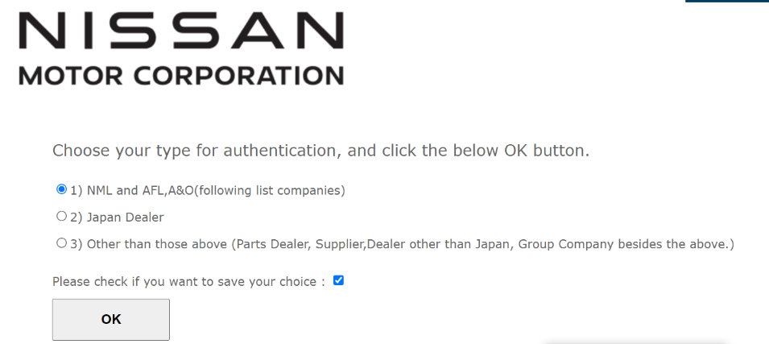
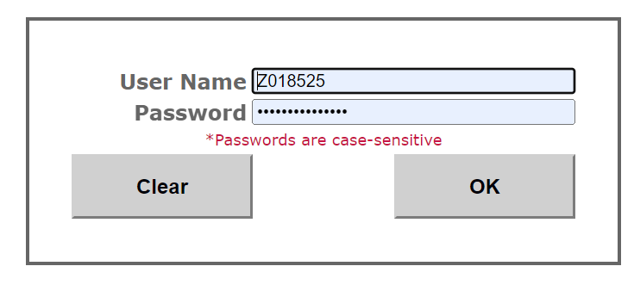
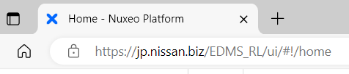
2.1. URL & Signing in
Step 1: Access URL : https://jp.nissan.biz/EDMS_RL/
Step 2: When login for first time, the screen below may appear. Please select 1 as below.
*If this screen doesn’t appear, please skip below step 2+3.
Step 3: Input your GD user ID and password. Then click OK. And now you will enter system.
To Logout, just click on “x” button in the browser to close the portal. No need for sign out.

Slide 6
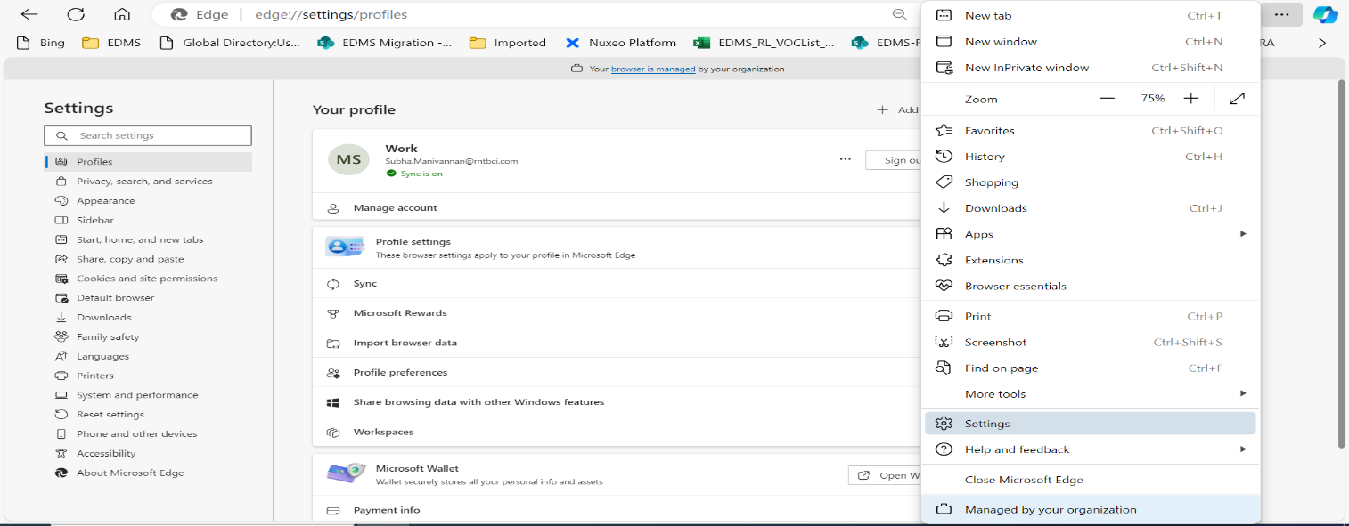
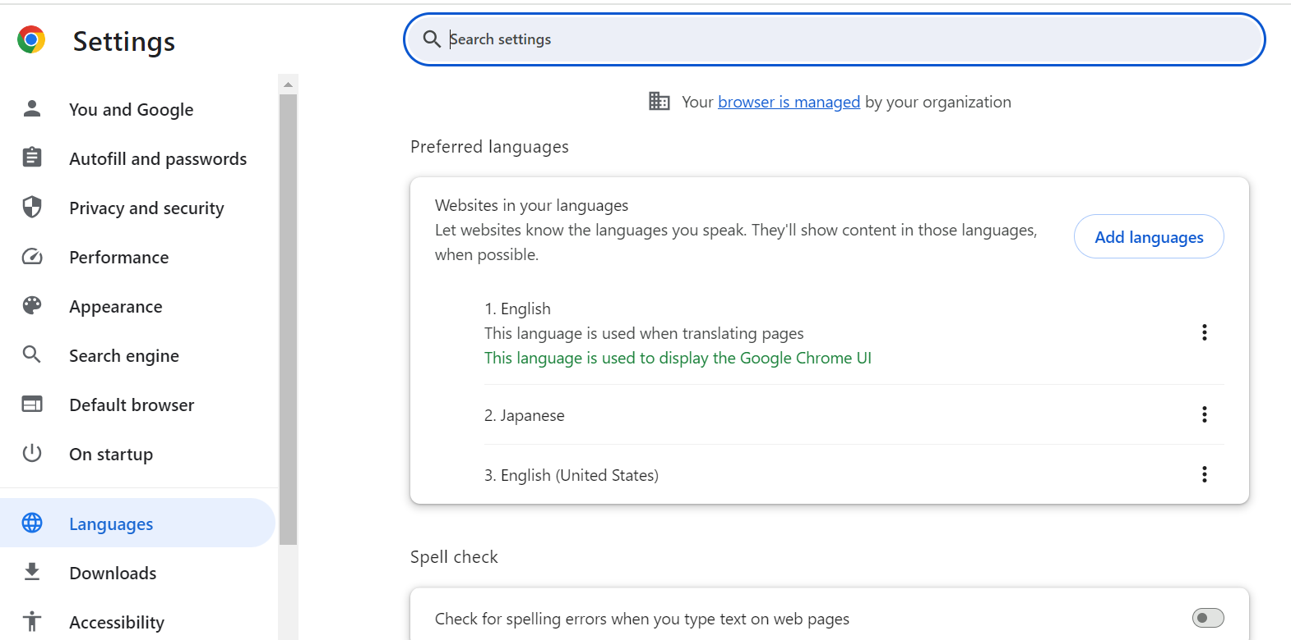
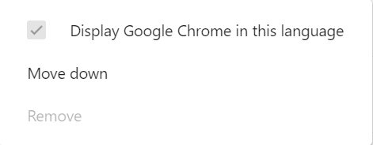
2-2.How to change Language
Step 1: Click on the below Icon in your browser
Step 2: Go to settings.
Step 1:Click on this icon
Step 2: Go to Settings
Step 3: Select [Languages] -> Select target language-> Check ON the box [Display Google Chrome in this Language].
Select this icon next to target language.
[Display Google Chrome in this Language] check box is shown. Turn ON the checkbox
Step3: Select [Languages]

Slide 7
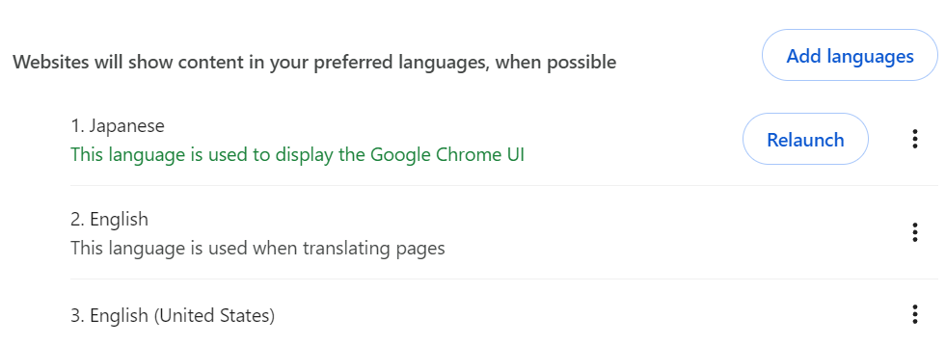
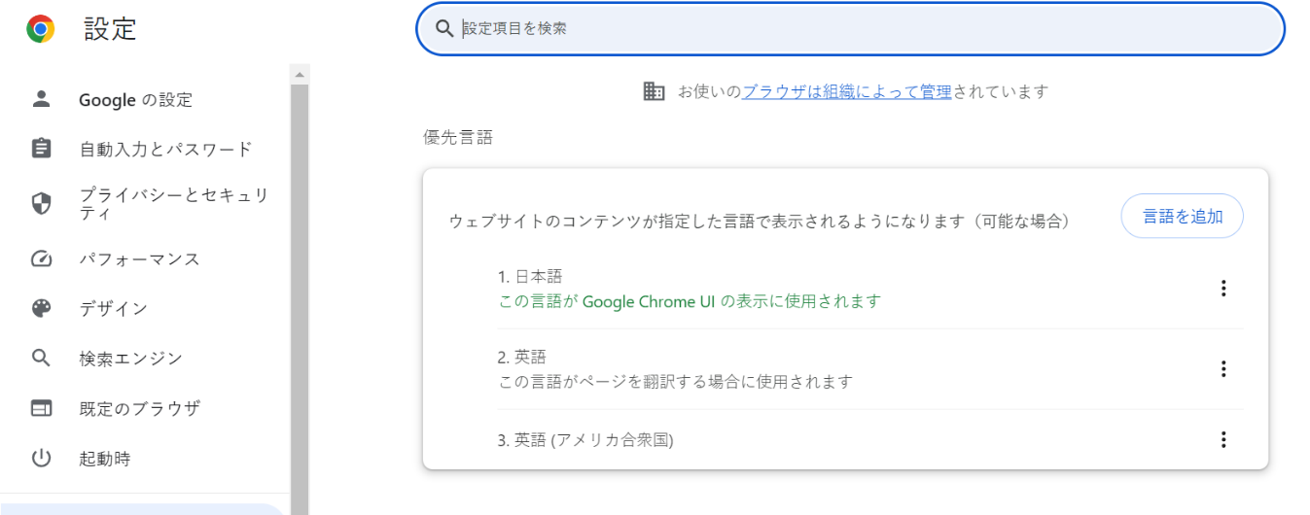
2-2.How to change Language
Step 4: Selected target language is moved to Top. Click [Relaunch] button. The browser appears in the selected language.
Step 4: Selected target language is moved to Top. Click [Relaunch] button.
The browser appears in the selected language.

Slide 8
3. Registration

Slide 9
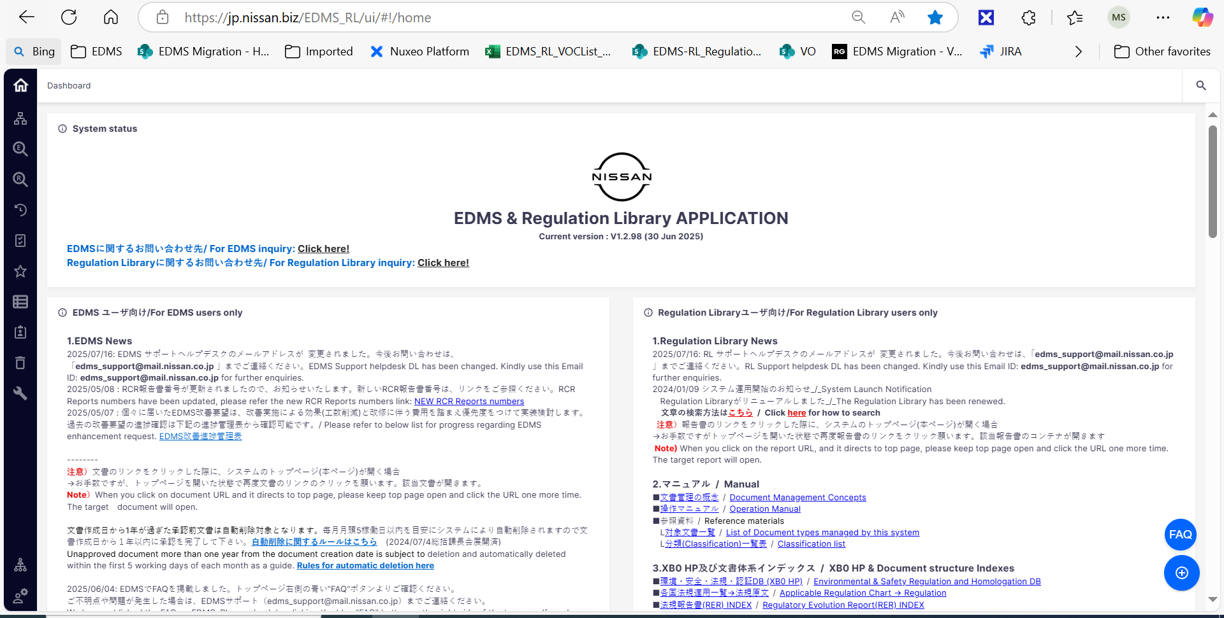
3-1.Home screen- Layout
①Home screen display
②Show document folder/
Start Registration
③Search documents
④Approval Task list
*For detail of all icons on Home screen,
please refer to HomeScreen Manual in below link:
https://jp.nissan.biz/EDMS_RL/ui/#!/doc/03fcf131-4a12-4699-bd6f-684119116cb2

Slide 10
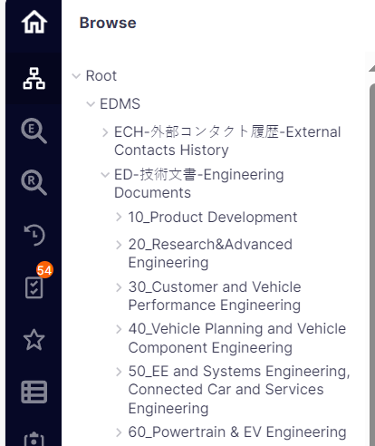
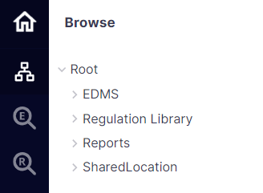
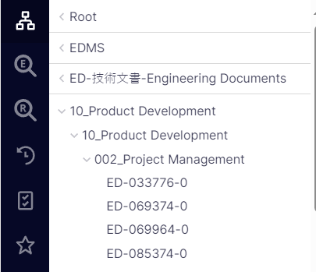
3-2.ED Registration
Step 1：Please click on [Browser] icon on left side menu and follow below steps to enter in ED registration screen.
①
1.Click [Browser]
②
③
2.Click folder [EDMS]
④
3.Click folder [ED-技術文書-Engineering Documents]
4.Select folder to create new document.
・In case of 002_Project Management, select folder [10_Product Development > 002_Project Management]

Slide 11
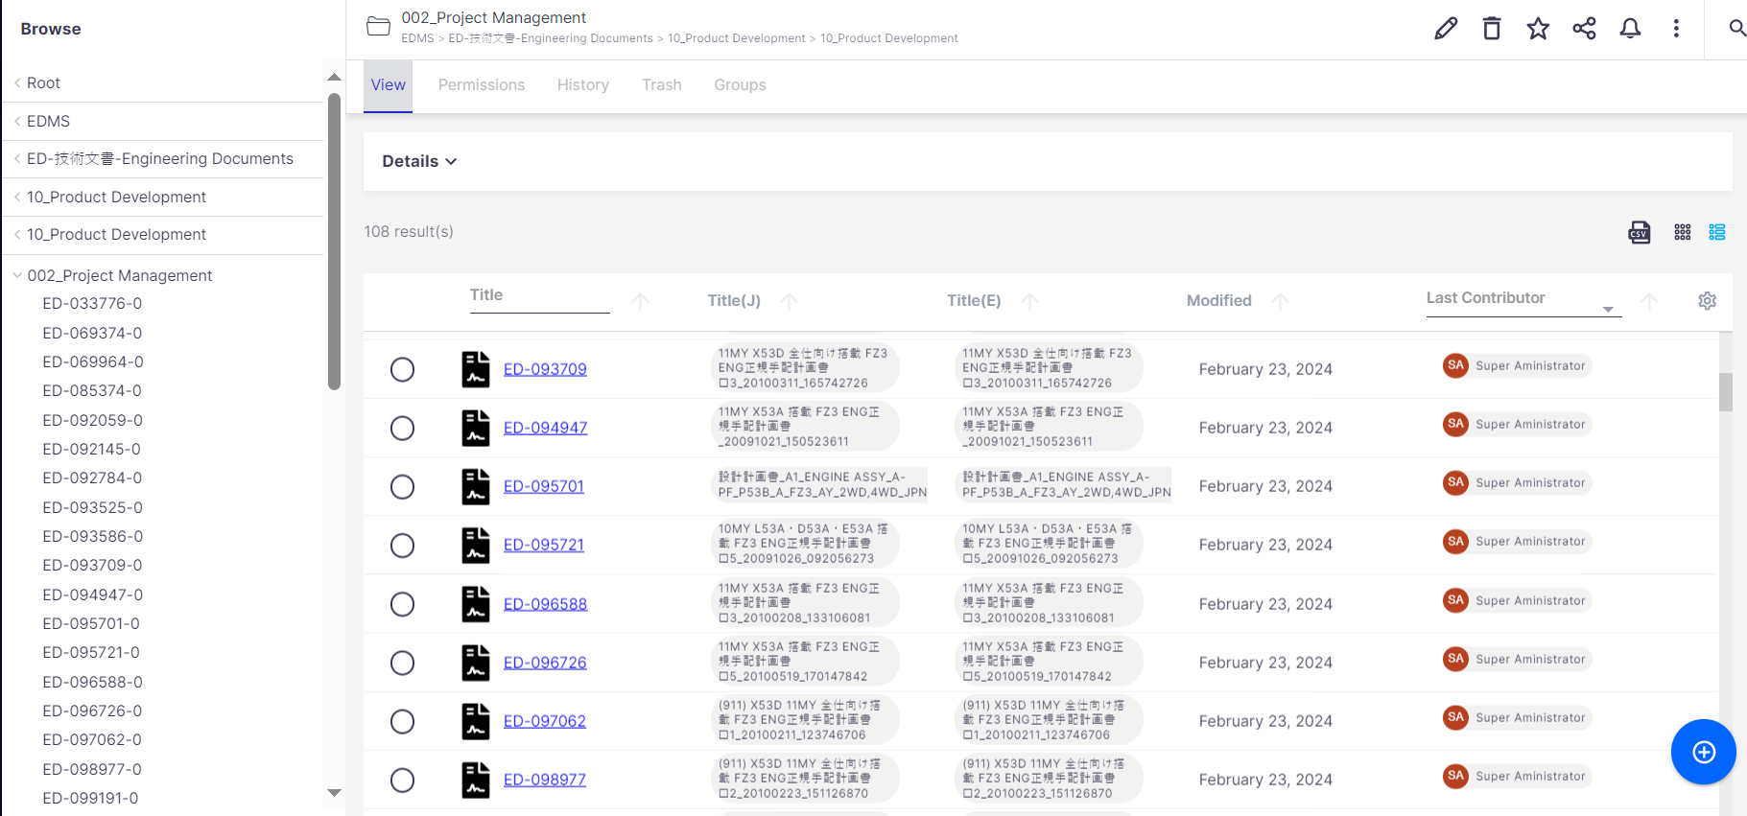
3-2.ED Registration
Step 2: The selected folder is displayed as below. Please select the blue + button in right corner of screen.
*Below image is a sample of the case you select [002_Project Management] folder.
②
2. Confirm document is stored in correct folder (same folder selected from left-side structure)
All documents created under current folder location are displayed here.
①
1. [002_Project Management] folder is selected
③
3. Click this icon to proceed RCR document registration.
Don’t click here
*Note: Please do not select the documents shown here in this step.
If you wrongly select and it shows some screens you don’t understand, pleasse re-login from beginning to do again.

Slide 12
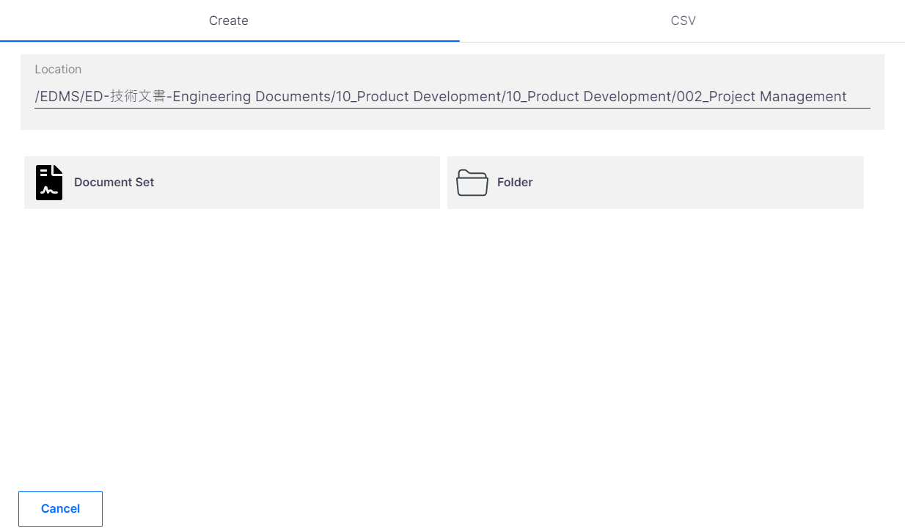
3-2.ED Registration
Step 3: [Create] screen is shown. Please click [Document set] option to register new ED Document.
Location:
Show path where store document
①
1. Click [Document set] option to register new ED document.
This [Folder] option is used for Admin user only.
Author/Viewer are unable to view this option.
If you want to cancel registration, you can click Cancel button here

Slide 13
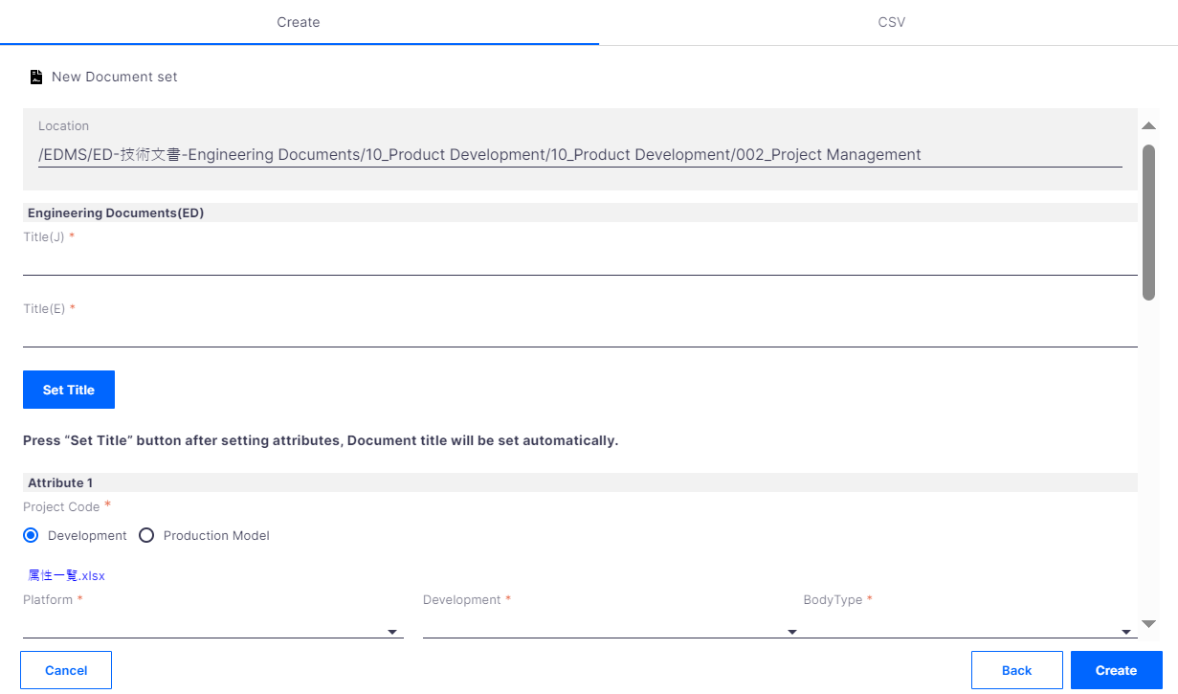
3-2.ED Registration
Step 4：In ED registration form, fill all necessary fields and click [Create] button on bottom right corner of screen to finish.
*Please refer to Explanation for all fields of ED registration screen for detail.
After click [Create] button, new document set is created. Please proceed to next steps to confirm [Metadata detailed screen] and perform [Attachment Upload].
If you click Back button, you can go back the previous screen of creation in Page 11
Click [Create] button to complete ED document registration form
If you want to cancel registration form, you can click Cancel button here

Slide 14
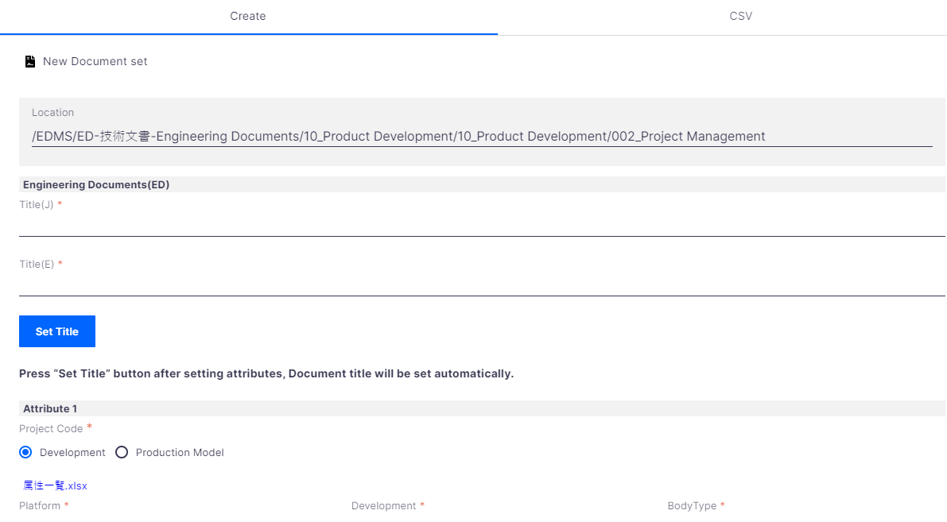
3-2.ED Registration
【Explanation for all fields of ED registration screen 1/3】
Fields with 「*」 mark are Mandatory. If you skip Mandatory fields, you cannot perform Registration.
①Location: Show folder path where Document Set is stored.
②Title(J), Title(E): You can input Japanese Title and English Title for this new document.
①
③Set Title:
you can generate Title by clicking button "Set Title“, based on the values of attributes: "Document Type“, “Project code”, ”Lot”.
②
④ Project Code：
Development: If you select "Development", Platform and Development are required to set. One or more values can be added.
Production Model: If you select "Production Model", Production Model and Platform are required to set.
③
④
⑤ Platform: Select correct value from the dropdown.
Development: Based on the Platform value selected, Development list/drop-down is displayed, select appropriate option.
BodyType: Select correct value from the drop-down.
⑤

Slide 15
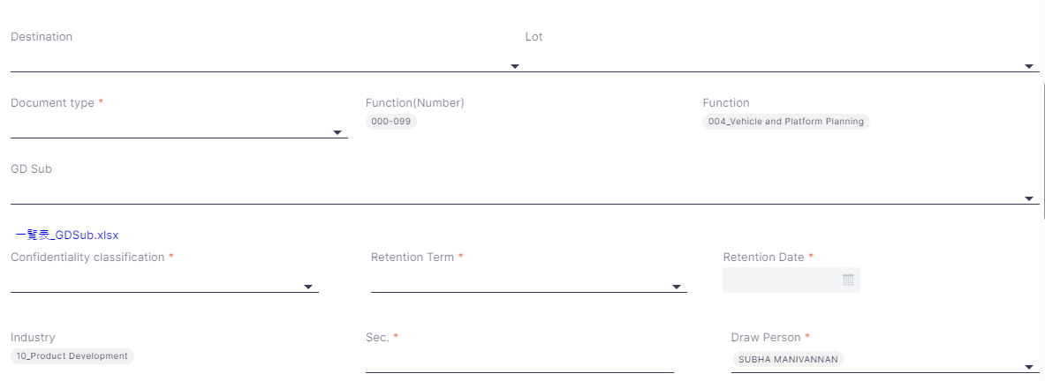
3-2.ED Registration
【Explanation for all fields of ED registration screen 2/3】
⑥
⑥ Destination, Lot: Select Correct value from Destination and Lot drop-down lists.
⑦
⑦
Document type: Select appropriate document type from drop-down list.
Function (Number), Function: auto-populated
⑧
GD Sub: Based on the document type and the function selected, GD- Sub list will be displayed. Select the appropriate one.
Click on the hyperlink to check the GD Sub values list.
⑧
Link to the file with GD Sub Details.
⑨
⑨ Confidentiality Classification: Select appropriate value.
Retention term: specifies how long the document set has to be retained.
Retention Date: auto-calculated based on Retention term.
⑩
⑩ Industry: auto-populated based on the folder name.
Sec, Draw Person: auto-fetched from the Login User details.

Slide 16
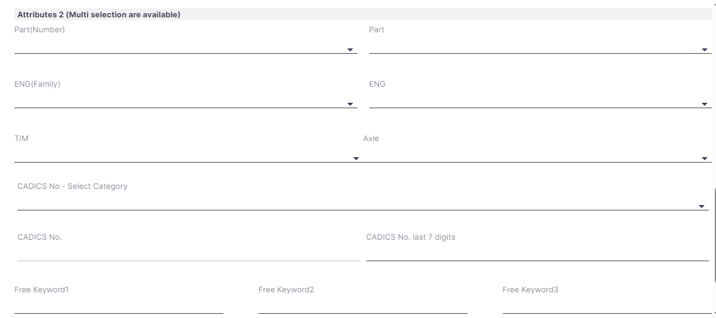
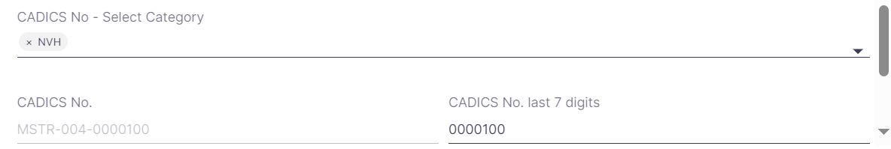
3-2.ED Registration
【 Explanation for all fields of ED registration screen 3/3 】
⑪
⑪ Part(Number): Select appropriate part number
Part: Based on the selected part number, the parts list gets displayed.
⑫
⑫ Similarly select Engineering family and Engineering values.
⑬
Select appropriate values for T/M and Axle from the lists.
⑬
⑭ CADICS No – Select Category: CADICS No. is a number which defines performance requirement. Select a category from the drop-down list.
CADICS No. last 7 digits: In the box below, type in numerals which correspond to CADICS.
CADICS No: The Corresponding Cadics no. will be auto-displayed here as in the below example.
⑭
⑮
⑯
Click on create button to complete ED Document set registration.
If you want to cancel this document creation, click this button.
Click this button, then you will return to create wizard window.
⑮ Free Keyword 1,2,3: We can provide Keywords here, which can be later used with Search function to identify this document set.
⑯ Comment(J), Comment(E): Input comment you may have regarding this document.

Slide 17
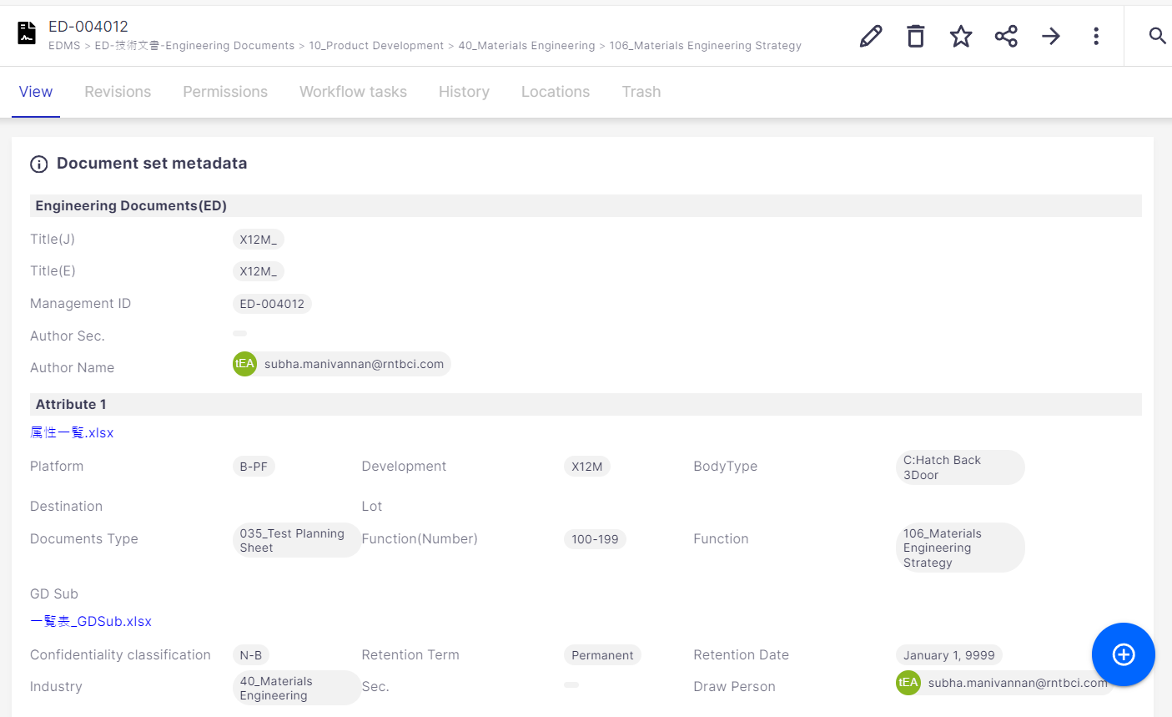
3-3. Attachment file upload
You can add attachment files into a document. To add file, first you should click blue + button on the bottom right of Document Detailed page.
Go to the Document detailed page:
Click on+ icon to upload an attachment.

Slide 18
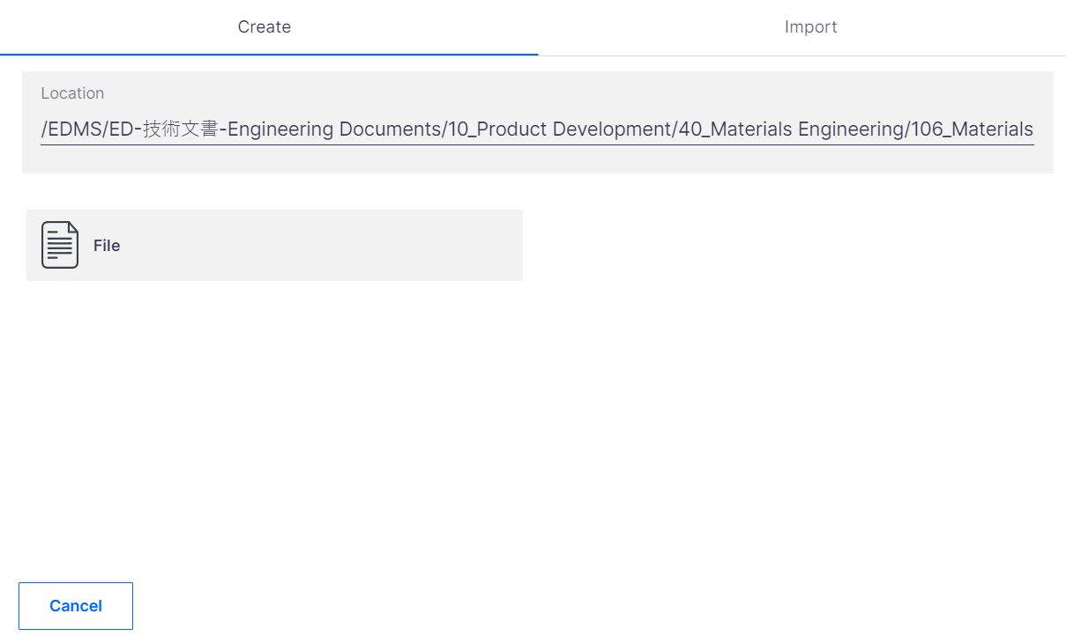
3-3. Attachment file upload
There are 2 ways to upload file:
①
②
To abort the file upload, click on Cancel button.

Slide 19
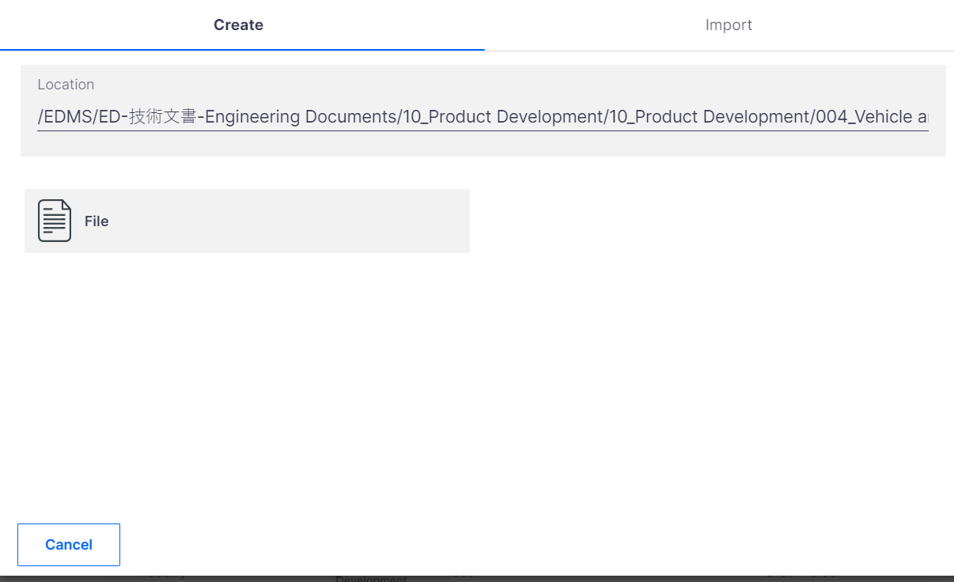
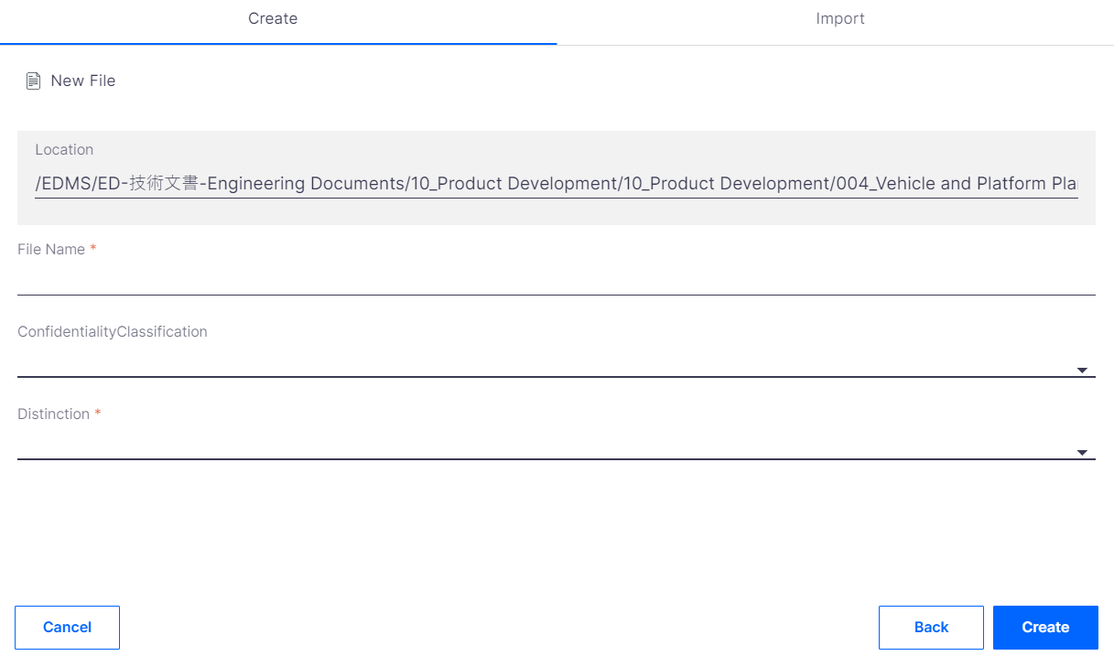
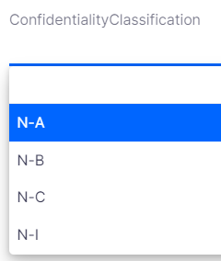
3-3. Attachment file upload
Way 1: Create File
① Click on Create
② Select File
①
① Location: where the file gets stored.
② File Name: Give an appropriate file name.
③ Confidentiality Classification : Select the applicable value from the drop-down list.
②
③
④
Click on Back to go back to previous page as in above picture
Click on Cancel to cancel uploading the attachment. Upon clicking cancel, detailed document screen displays.
Click on Create to complete file creation.

Slide 20
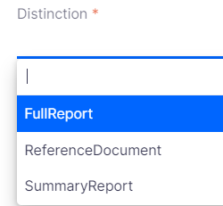
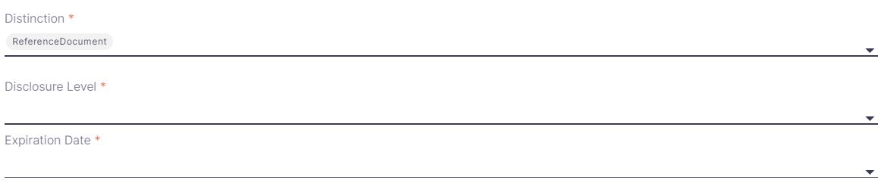
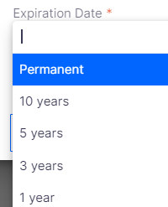
3-3. Attachment file upload
④ Distinction: Give proper distinction for the file.
a
b
c
a. Fulldocument: upon selecting this option, we can click on Create button to create a file.
b. ReferenceDocument: The below options appear. Provide user name for Disclosure Level and select Expiration Date from the drop-downlist.
C. Summarydocument: upon selecting this option, we can click on Create button to create a file.

Slide 21
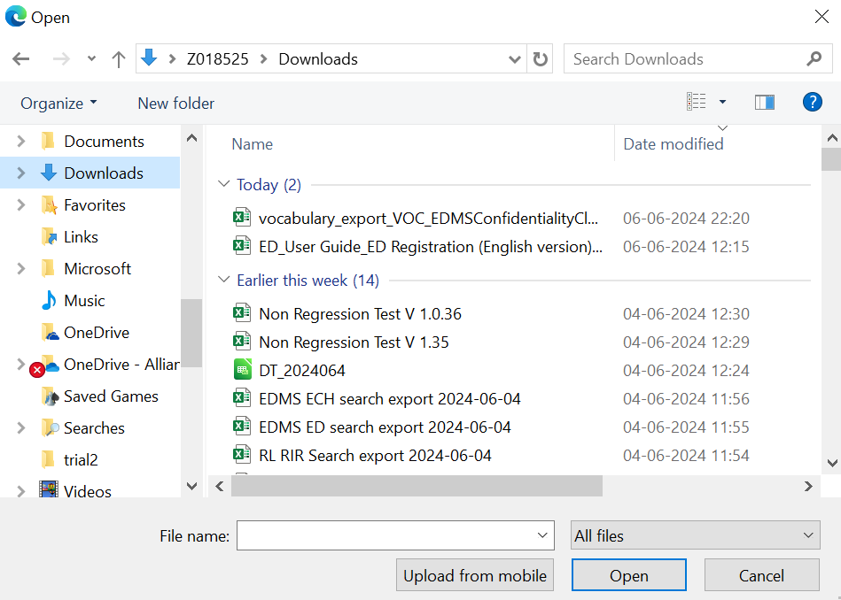
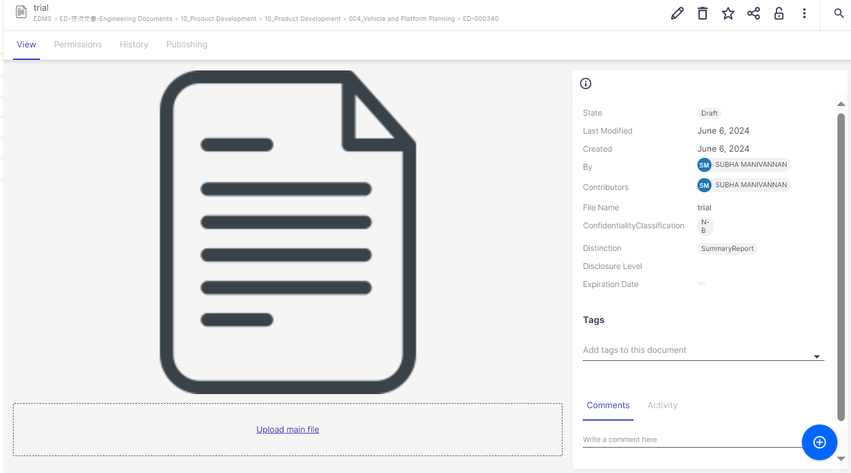
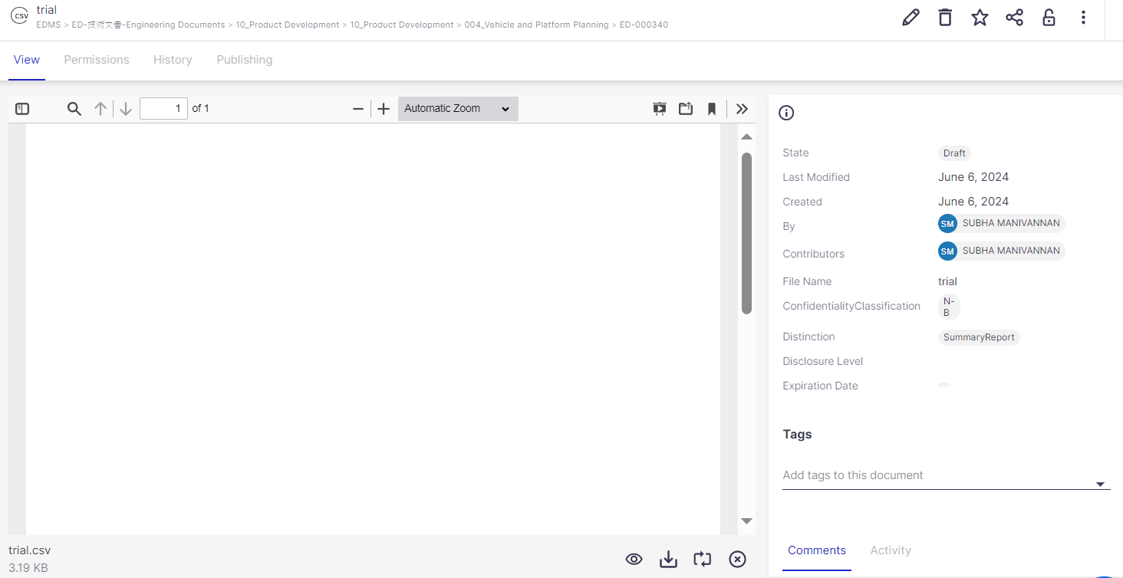
3-3. Attachment file upload
Upon clicking Create button, we get the below screen
Click here to upload the file
Select the required file and click on Open
File is uploaded

Slide 22
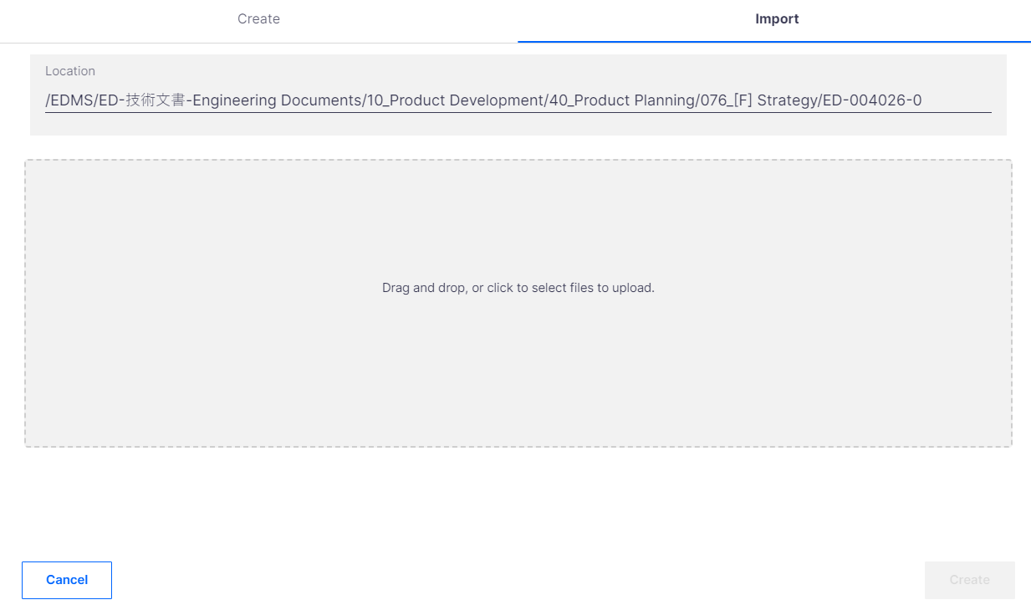
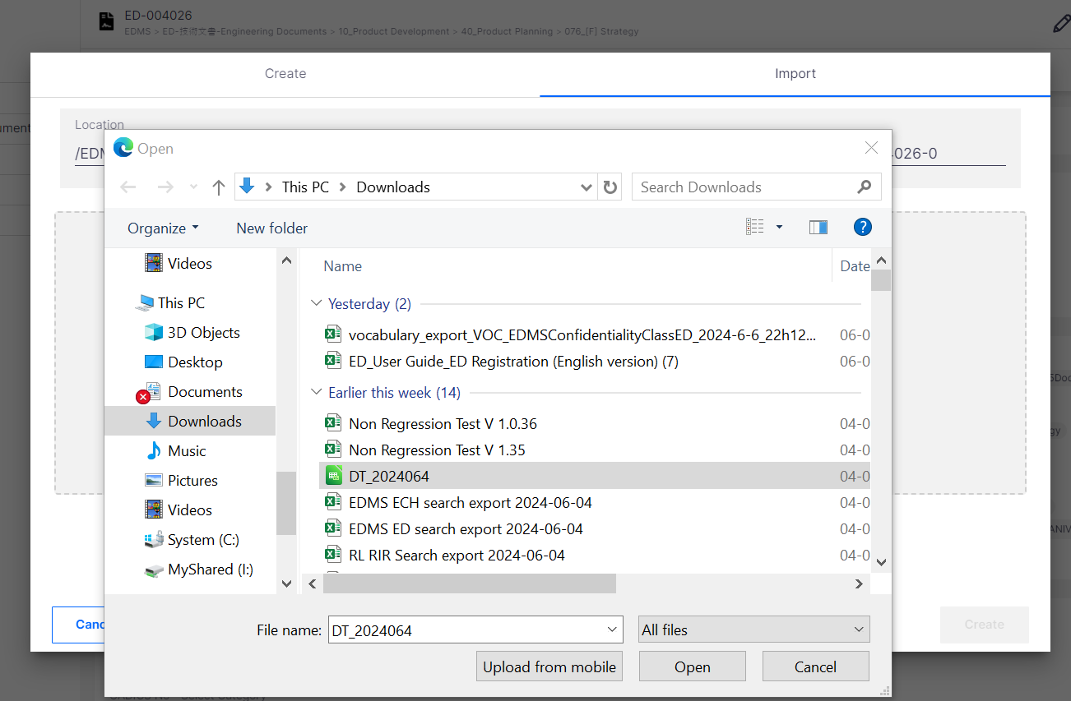
3-3. Attachment file upload
①
Click on Import
Way 2: Import file
②
Click here
③
Select the required file

Slide 23
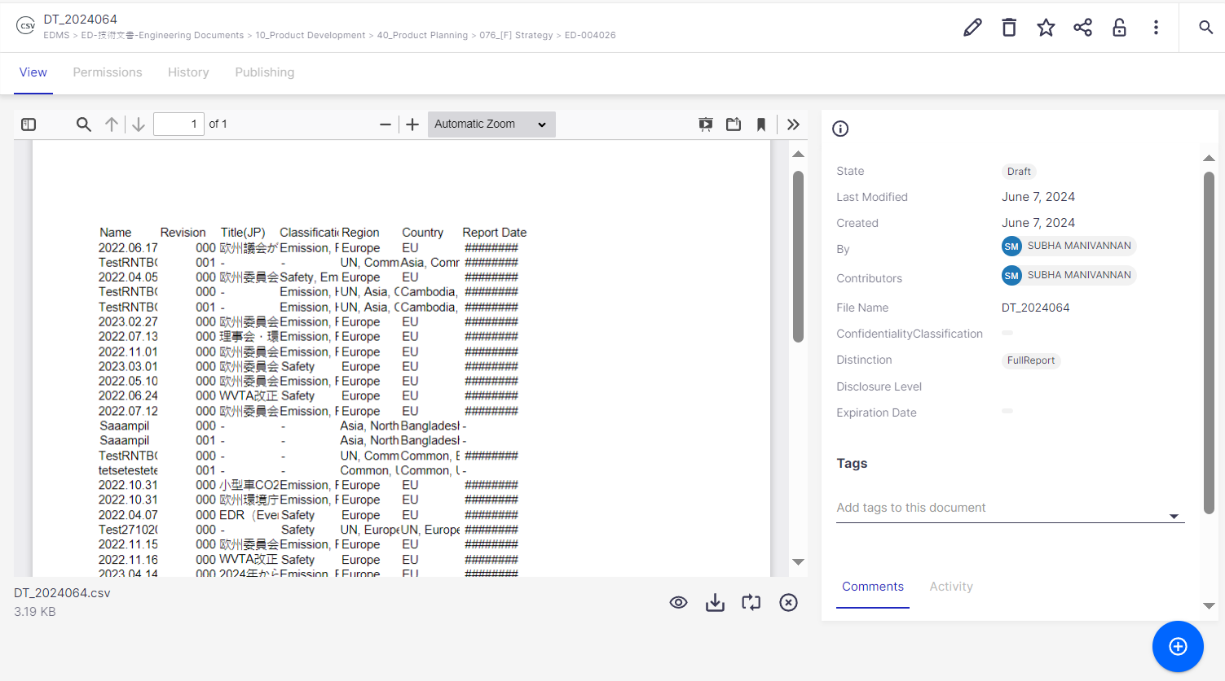
3-3. Attachment file upload
File gets uploaded.

Slide 24
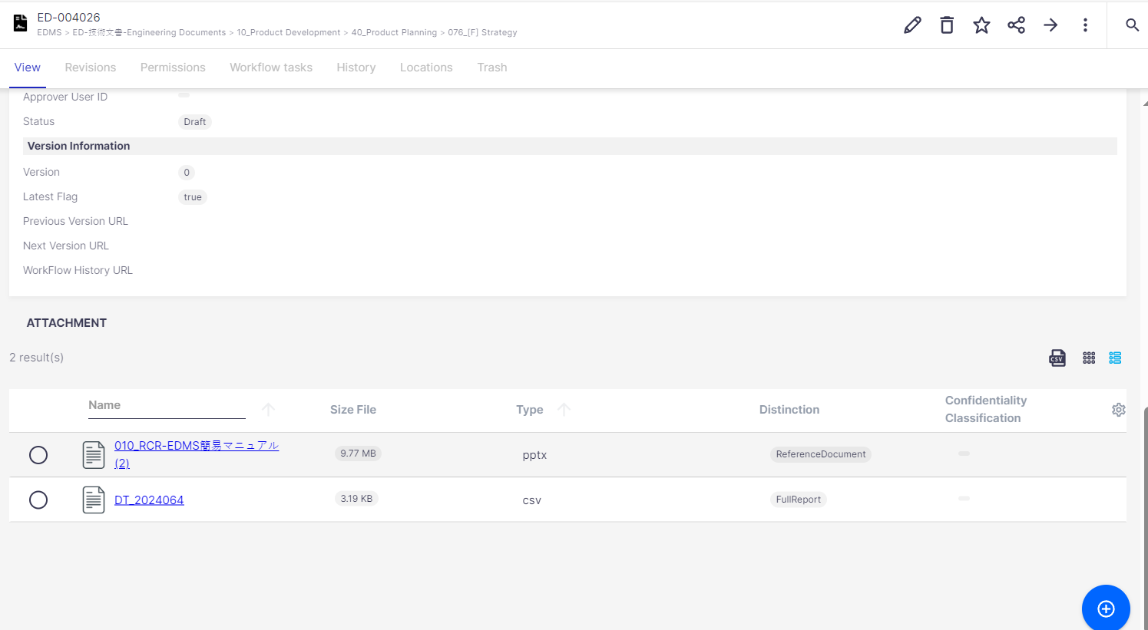
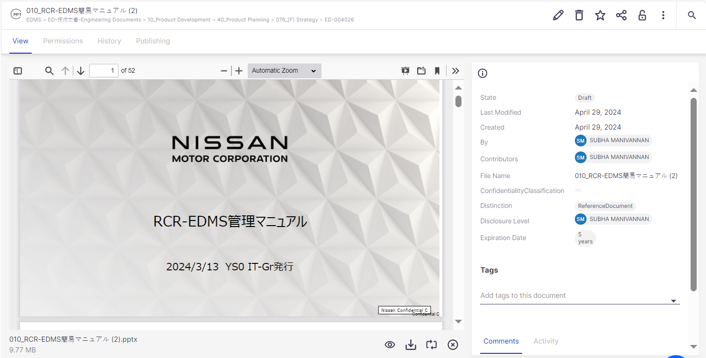
3-3. Attachment file upload
After you click the "Create" button, your file will be created and added as an attachment to your document. Once you see the below, your attachment has been uploaded successfully.
This area displays the actions available for the current file. The display of buttons depend on the user's access rights and the current status of the document.
List of uploaded files. Click on the file to view details like the image on the right.
You can also perform the following operations on the uploaded files (see "Attachment Details" for details)
If you have more attachments, click the blue-white + button on the document screen and repeat the attachment upload flow.

Slide 25
Thank you

